Slide 1
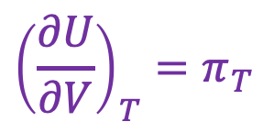
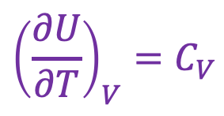
Back to U as a thermodynamic surface: there’s another slope too!
$${\left(\frac{∂U}{∂V}\right)}_{T}=π_{T}$$
U(T,V)
$${\left(\frac{∂U}{∂T}\right)}_{V}=C_{V}$$
V
“State Space”
T

Slide 2
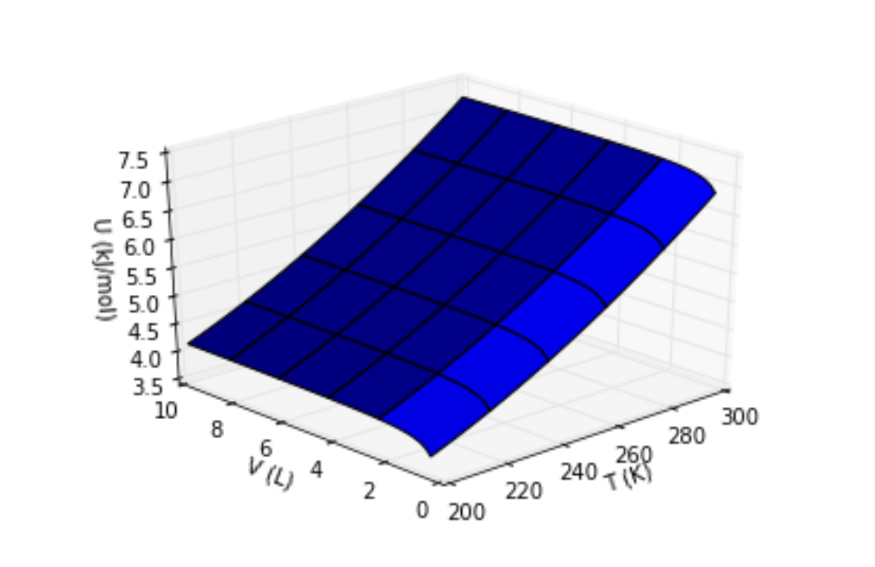


A more realistic depiction of $U(T,V)$
$$π_{T}$$
$$C_{V}$$
Isochoric heating experiment
Isothermal expansion experiment

Slide 3
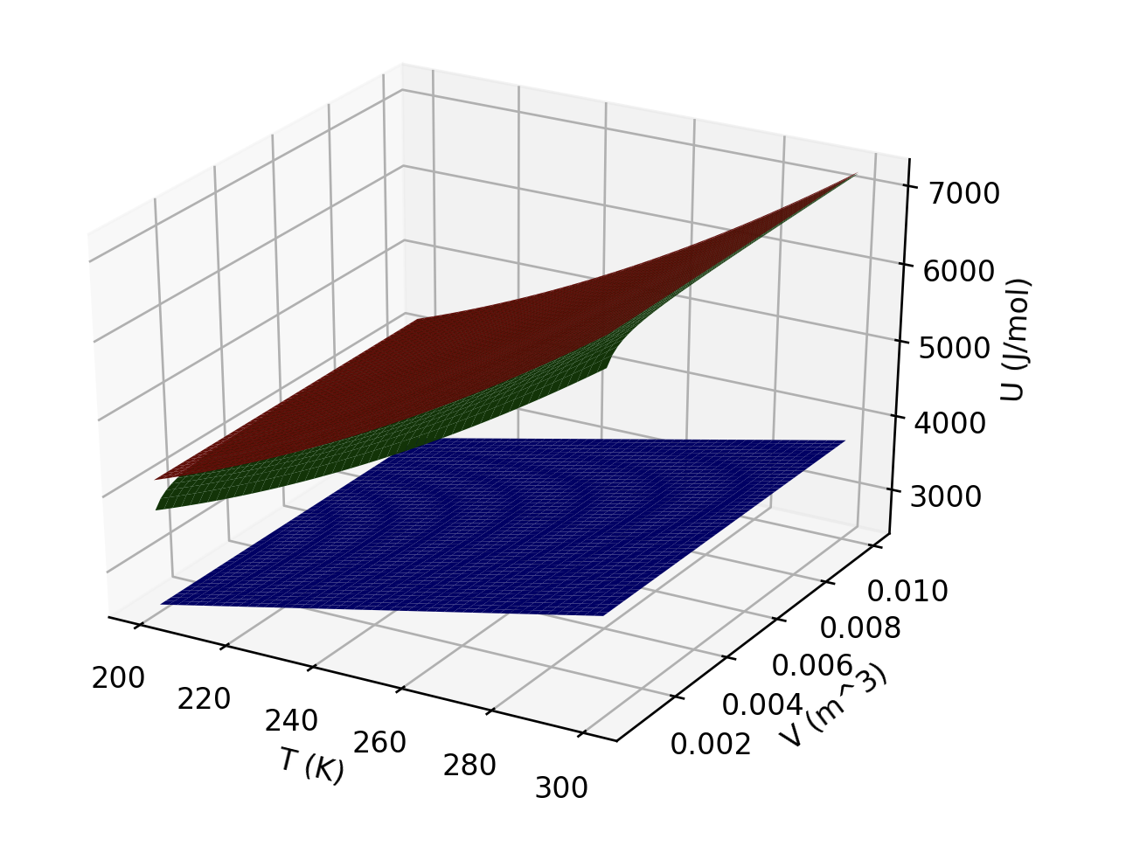
$U(T,V)$of three gases are depicted here

Slide 4
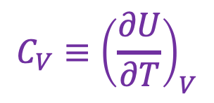
What do you suppose $CV(T,V)$ looks like for the lowest surface?
$${C_{V}≡\left(\frac{∂U}{∂T}\right)}_{V}$$

Slide 5
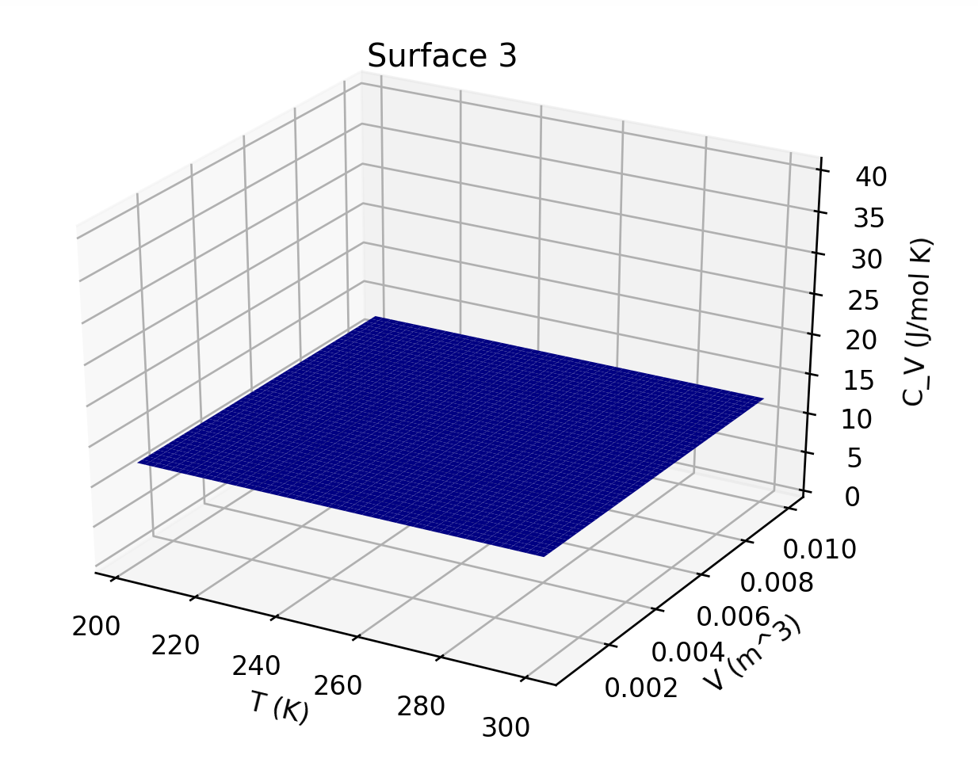
What do you suppose $CV(T,V)$ looks like for the lowest surface?
$${C_{V}≡\left(\frac{∂U}{∂T}\right)}_{V}$$

Slide 6
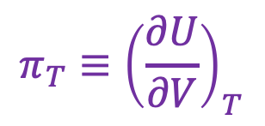
What do you suppose $πV(T,V)$ looks like for the green surface?
$$π_{T}≡{\left(\frac{∂U}{∂V}\right)}_{T}$$

Slide 7
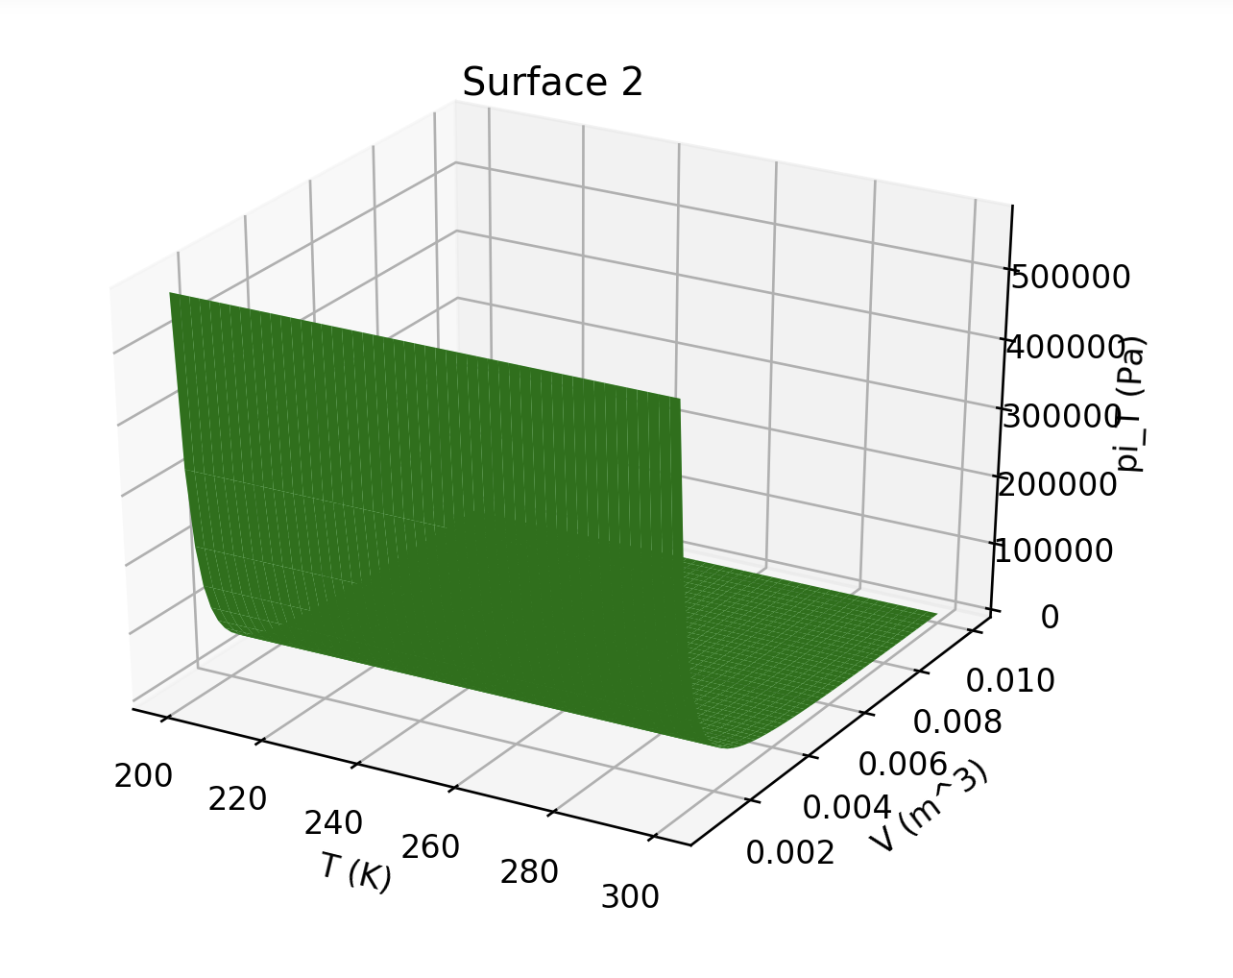
What do you suppose $πV(T,V)$ looks like for the green surface?
$$π_{T}≡{\left(\frac{∂U}{∂V}\right)}_{T}$$

Slide 8
